Slide 1


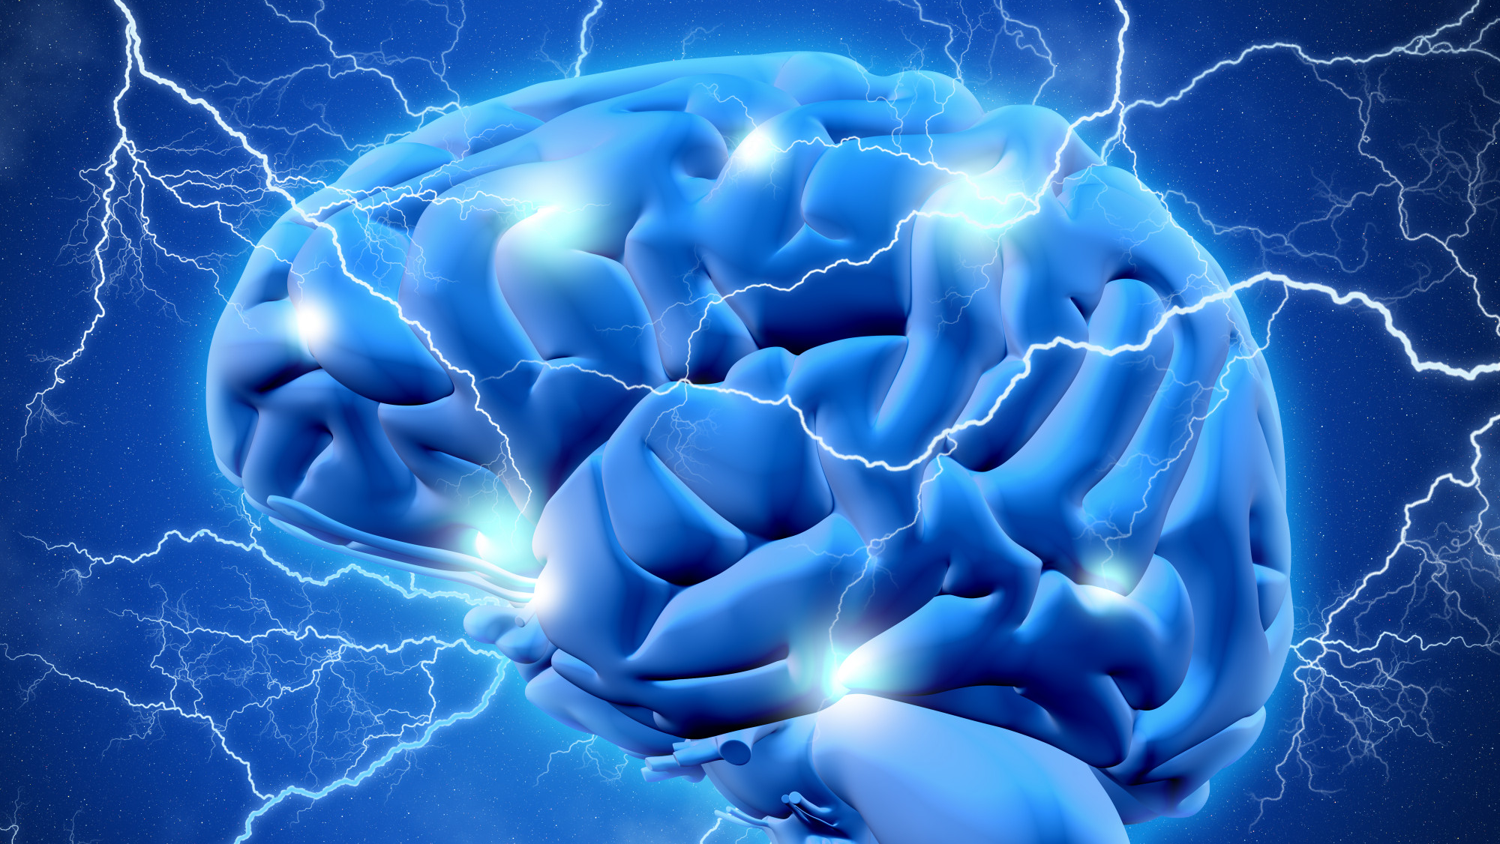
Stroke Prediction Dashboard
Project 4 | Team 3
Lauren, Kathleen, Satya, & Megan
<a href="https://www.freepik.com/free-photo/3d-brain-with-lightening_6214247.htm#query=brain%20stroke&position=27&from_view=keyword&track=ais">Image by kjpargeter</a> on Freepik

Slide 2
What is a stroke
According to the CDC a stroke, sometimes called a brain attack, occurs when something blocks blood supply to part of the brain or when a blood vessel in the brain bursts. In either case, parts of the brain come damaged or die. A stroke can cause lasting brain damage, long-term disability, or even death.
There are 3 different types of strokes?
Transient Ischemic Attach (TIA) – ‘mini stroke’ caused by a temporary clot
Ischemic Stroke – clot obstructing the flow of blood to the brain
Hemorrhagic Stroke – blood vessel rupturing and preventing blood flow to the brain

Slide 3
Signs of a Stroke
There are 5 main warning signs of a stroke.
Numbness or weakness in the face, arm, or leg
Confusion or trouble speaking or understanding speech
Trouble seeing in one or both eyes
Trouble walking, dizziness or balance problems
Sever headache with unknown cause

Slide 4
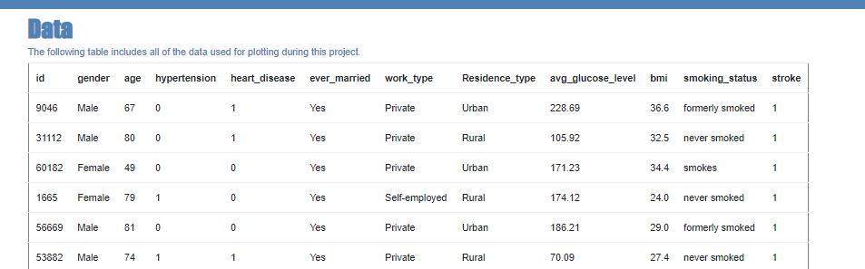
Data and data delivery
Used a Stroke Prediction Dataset from Kaggle that contained 11 clinical features for predicting stroke events.
Data was cleaned, to drop null values, changed the age column data type.
Output model is hosted on Render.

Slide 5
Supervised Machine Learning
Logistic Regression
Random Forest

Slide 6
Logistic regression
Training Data Score: 0.96
Testing Data Score: 0.95
Actual: [0, 0, 0, 0, 0, 0, 0, 0, 0, 0]
Predicted: [0, 0, 0, 0, 0, 0, 0, 0, 0, 0]
Confusion matrix
array([ [1165, 0],
[ 63, 0]], dtype=int64)
Logistic Regression Accuracy: 0.9486 (94.9%)

Slide 7
Random Forest
Training Score: 1.0
Testing Score: 0.9462
Random Forest Classifier Accuracy: 0.94625 (94.63%)

Slide 8
Stroke Prediction Dashboard
Dashboard was created that allows the end user to input some information (via drop down fields)
Once the user enters in their information the dashboard will determine if they are likely to have a stroke in the future or not.
The more details a user enters; the better the predictor will be.
Options for indicators are
Age
Gender
Hypertension
Heart Disease
Average Glucose Level
BMI
Smoking Status

Slide 9
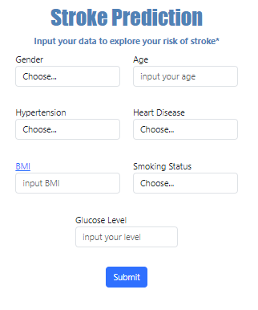
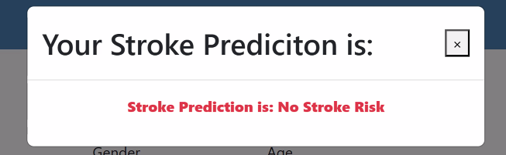
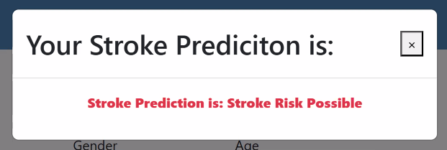
Stroke Prediction Dashboard
Out of the 4909 patient data points in our dataset; 209 had a stroke (4.3%) of our dataset.

